Slide 1
PHD Progression 15
Explainable AI with visual analytics

Slide 2
Proof of concept
Attention Entropy as an Interpretability Signal
Shannon entropy H = -Σ p log p measures the uncertainty or spread of a probability distribution. Applied to an attention weight distribution over T tokens, it quantifies how “focused” versus “diffuse” a head’s attention is:
H = 0: the head attends entirely to one token (maximally focused, like a retrieval operation).
H = log T: the head attends uniformly to all tokens (maximally diffuse, like a global average-pooling operation).
Intermediate values: the head attends selectively to a subset of tokens.

Slide 3
Dimensionality Reduction for Neural Representations
PCA (Principal Component Analysis) finds the directions of maximum variance in the dataset. It is linear, deterministic, and preserves global structure (tokens far apart in 512D will be far apart in 2D). The explained variance ratio for each component is computable and displayed in the sidebar, giving the user a measure of how much information the projection retains.
t-SNE (t-Distributed Stochastic Neighbour Embedding) is a non-linear technique that prioritises preserving local neighbourhoods. Tokens that are similar in 512D will be placed close together in 2D, even if this distorts global distances. t-SNE is better at revealing cluster structure but slower and non-deterministic without a fixed seed.

Slide 4

Property | PCA | t-SNE (default)
Preserves | Global variance structure | Local neighbourhood structure
Speed | Very fast (< 1ms) | Slower (~100–500ms)
Interpretability | Axes have meaning (PC1 = max variance) | Axes have no inherent meaning
Best for | Comparing layers (consistent projection) | Revealing semantic clusters
Implemented as | StandardScaler → PCA | PCA(10) pre-reduce → t-SNE

Slide 5
Residual Stream as a Communication Channel
Modern transformers use residual connections: the output of each sub-layer is added to its input rather than replacing it. This creates a “residual stream” a running sum that accumulates information across all layers:
h^{l+1} = h^l + Attention(h^l) + FFN(h^l + Attention(h^l))
The residual stream is the primary object that mechanistic interpretability researchers study, because it is the medium through which all information in the model flows. The green “residual” edges in the visualisation represent this same-token cross-layer connection, making the stream’s continuity visible. The activation norm ||h^l_t||_2 measures how much information has been added to the stream for token t up to layer l.

Slide 6
Hierarchical Clustering in Representational Space
Ward linkage hierarchical clustering groups tokens whose 512-dimensional representations are similar. In the context of language models, tokens from the same syntactic category (nouns, verbs, function words) tend to cluster together in the representation space, because the model has learned to encode part-of-speech information in the hidden states.

Slide 7
TinyStories-33M Architecture
Parameter | Value | Notes
Architecture | GPT-Neo | EleutherAI decoder-only transformer
N_LAYERS | 4 | Transformer blocks
N_HEADS | 16 | Verified from live model config.json
D_MODEL | 512 | Hidden state dimension
HEAD_DIM | 32 | D_MODEL / N_HEADS = 512 / 16
Context length | 512 tokens | Per paper; HF config reports 2048 (discrepancy)
Tokeniser | GPT-Neo BPE | 50,257-token vocabulary
Norm range | 4.0–12.0 | Pre-LN residual stream, empirically verified
TinyStories-33M (roneneldan/TinyStories-33M on HuggingFace) is a GPT-Neo variant trained on TinyStories. The verified architecture parameters, read directly from the live model config.json, are as follows:

Slide 8
How to Evaluate This Proof of Concept
Test | What it verifies | Expected result
Attention row-sum | Each row of every attention matrix sums to 1.0 | |sum - 1| < 1e-5 for all layers, heads, tokens
Entropy bounds | Per-head entropy H ∈ [0, log T] for all l, h | 0 ≤ H ≤ 2.485 for T=12 tokens
Norm bounds (synthetic) | ||h^l_t||_2 ∈ [4.0, 12.0] for all layers and tokens | Verified at startup; printed to console
Architecture match | N_HEADS, N_LAYERS, D_MODEL match live model config | Constants updated and logged at model load
Subword alignment | Word-level attention rows sum to 1 after pooling | Re-normalisation applied; same test as row-sum
Graph connectivity | Every token node connected to its layer hub | T × L spoke edges present in graph JSON

Slide 9
PCA Explained Variance Threshold
If the top-2 PCA components explain less than 30% of variance, the 2D PCA projection is losing most of the representational information. For TinyStories-33M with 6-12 tokens, the system should show PC1 ≈ 20–30%, PC2 ≈ 12–18%, consistent with representations that lie on a low-dimensional manifold. Significantly lower values would suggest the representations are isotropic (no structure) or the tokenisation is producing degenerate representations.

Slide 10
Human-Centred Evaluation
Target participants: 12–16 researchers with backgrounds in NLP, machine learning, or computational linguistics, divided into two groups:
Expert group (n=6-8): active transformer researchers with familiarity with attention mechanisms.
Novice group (n=6-8): graduate students with ML background but limited transformer interpretability experience.

Slide 11
# | Task | What it tests | Scoring
T1 | Identify the layer with highest attention entropy | Reading the layer entropy bars in the sidebar | Binary correct/incorrect
T2 | Find what token ‘she’ attends to most in Layer 2 | Reading the attention heatmap for a specific head | Binary + time to answer
T3 | Do same-class tokens cluster together at Layer 4? | Interpreting cluster colours in the graph | Binary + justification
T4 | Which attention head is most focused (lowest entropy)? | Reading the per-head entropy list in the Inspector | Binary correct/incorrect
T5 | Compare residual norms of first and last token across layers | Reading the norm bars and switching between layers | Directionally correct + explanation

Slide 12
Why Language Models Hallucinate
(1) Pretraining makes hallucinations statistically inevitable. Even if pretraining data were 100% correct, the cross‑entropy objective forces the model to approximate a distribution in a way that necessarily induces errors, analogous to errors in binary classification.
(2) Post-training reinforces hallucinations. Most benchmarks use binary accuracy metrics, where expressing uncertainty (“I don’t know”) is scored as zero, while guessing is sometimes rewarded. This pushes models toward overconfident falsehoods.

Slide 13
Why Pretraining Causes Hallucinations
The central technical contribution is a reduction from generative modeling to binary classification. The authors define an “Is‑It‑Valid” (IIV) classification problem and prove:
This means:
If the model cannot reliably classify valid vs. invalid outputs…
…it cannot avoid generating invalid (hallucinatory) text.

Slide 14
Why Post‑Training Fails to Remove Hallucinations Despite RLHF, DPO, RLAIF, etc., hallucinations persist.
The authors argue this is because:
Benchmarks overwhelmingly reward guessing.
Most evaluations (MMLU, GPQA, MATH, SWE‑bench, etc.):
score answers as correct/incorrect
give zero credit for expressing uncertainty
provide no incentive to output “I don’t know”

Slide 15
Proposed Solution: Fix the Evaluations, Not the Models
This aligns incentives so:
With high thresholds, models learn to abstain more.
Uncertainty becomes a valid strategic response.
Leaderboards become hallucination‑aware.

Slide 16

A Geometric View of Transformer Representations
The authors characterize hidden representations using two complementary geometric tools:
Intrinsic Dimension (ID): Measures the effective dimensionality of the data manifold embedded in the representation space.
Neighborhood Overlap: Tracks how local neighborhoods of data points rearrange across layers.

Slide 17
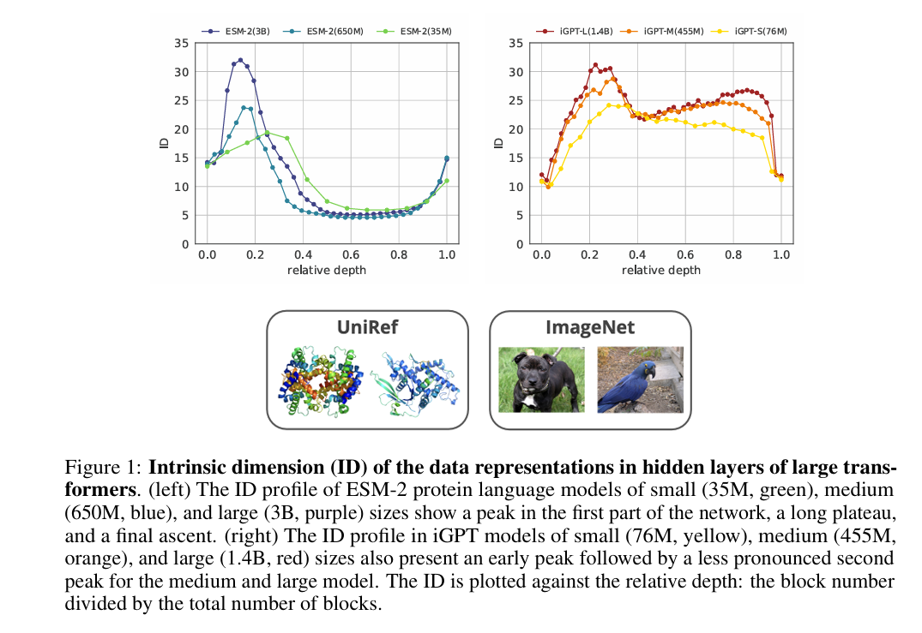
Universal Three‑Phase (or Four‑Phase) Representation Dynamics

Slide 18
Expansion phase (early layers)
Rapid growth in intrinsic dimension
Strong reshuffling of nearest neighbours
Analogous to feature expansion in kernel methods

Slide 19
Compression phase (intermediate layers)
Sharp decrease (or plateau) in intrinsic dimension
Representations become low‑dimensional and stable
Semantic information emerges here

Slide 20
Decoding / reconstruction phase (late layers)
Intrinsic dimension rises again
Neighborhoods rearrange to support the reconstruction objective

Slide 21
(iGPT only) Second shallow peak
Suggests an autoencoder‑like symmetry between encoding and decoding

Slide 22
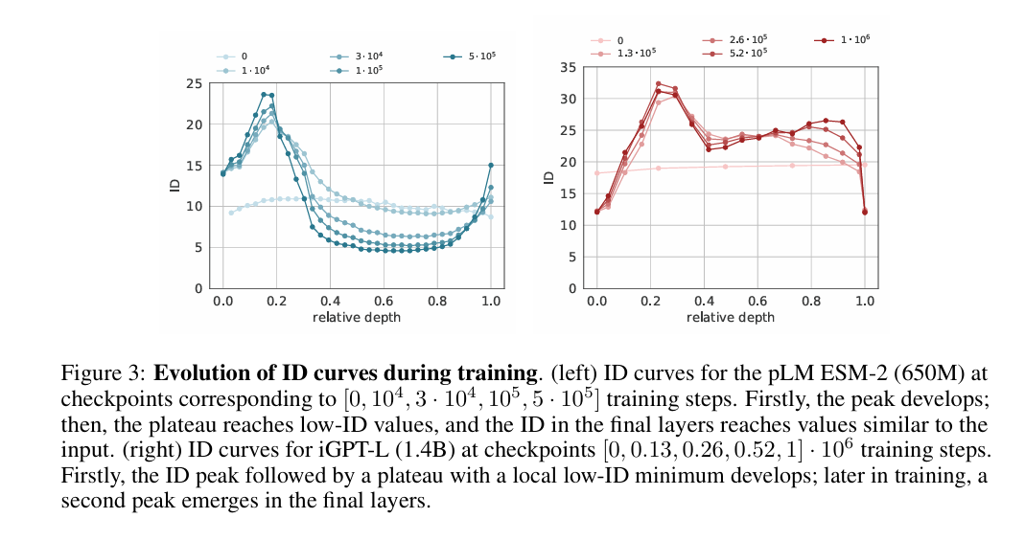

Slide 23
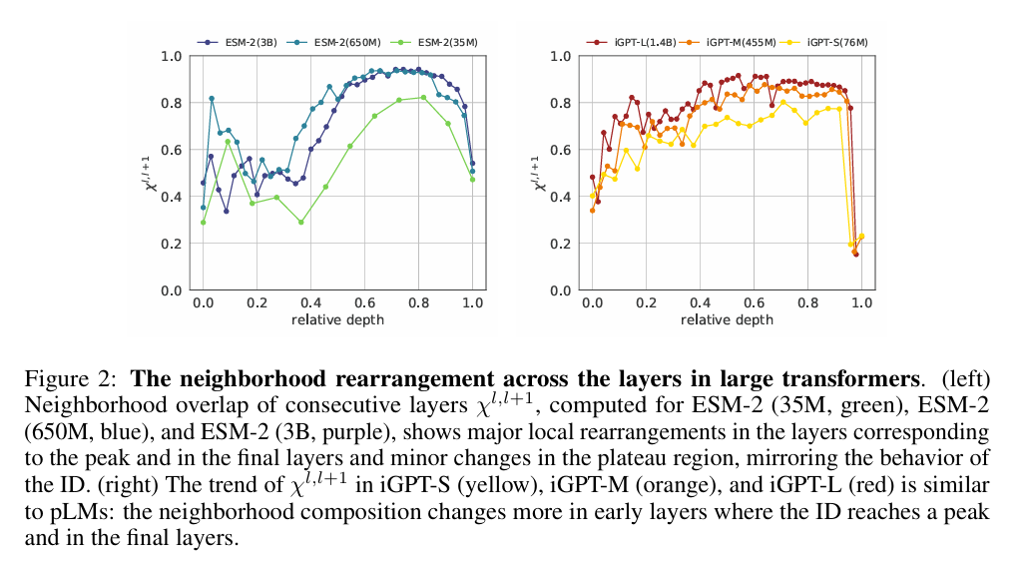

Slide 24
Semantic Information Peaks at Low Intrinsic Dimension
Proteins: Remote homology information (SCOPe superfamilies) peaks in the low‑ID plateau, not the final layer.
Images: ImageNet class information peaks at the local minimum of the ID curve, around mid‑depth.
This holds consistently across model sizes, with stronger effects in larger models. 1

Slide 25
Practical Implication: Unsupervised Layer Selection
The ID profile can be used as a model‑ and task‑agnostic criterion to:
Identify layers best suited for downstream tasks
Improve nearest‑neighbor search and linear probing without fine‑tuning
Outperform representations taken from the last hidden layer in tasks like protein homology search

Slide 26
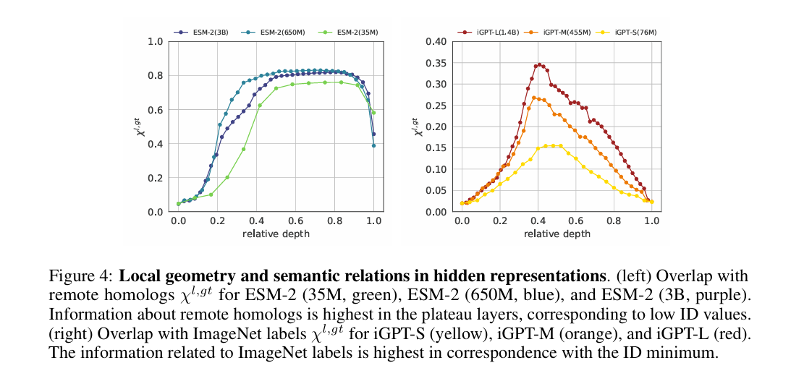

Slide 27
Conceptual Interpretation
The authors argue that large transformers behave like sophisticated autoencoders:
Encode: Expand then compress data into a low‑dimensional semantic manifold
Decode: Re‑expand representations to reconstruct the input

Slide 28

From Black-Box to Glass-Box: A User‑Centric Framework for Explainable Visualization with LLMs
introduces a framework aimed at making LLM‑generated data visualizations more explainable and trustworthy. It expands the original LIDA system and proposes LIDA++, an enhanced, user‑centric version designed to solve interpretability issues in visualization recommendation systems.

Slide 29
Limitations of Previous Approaches
Rule‑based visualization systems → hard to maintain and don’t generalize well.
ML‑based systems (e.g., VizML, DeepEye) → high training cost, model bias, still black‑box.
XAI methods like LIME and SHAP → useful but computationally heavy and may provide unintuitive explanations.

Slide 30
What LIDA++ Improves
Goal Explorer & Goal Analyzer — separates goal generation into more transparent modules.
Improved data summarization — reduces token usage and hallucinations; supports wider datasets.
Visualization Evaluator — a new scoring mechanism evaluating charts more reliably.
ImageEvaluator (multimodal LLM) — evaluates charts on clarity, accuracy, insightfulness, compliance, etc.
More consistent scoring (SEVQ modifications) — replaces free‑text scoring with logic‑based, structured evaluation.
Interface improvements — landing module, playground module, and improved user guidance.

Slide 31
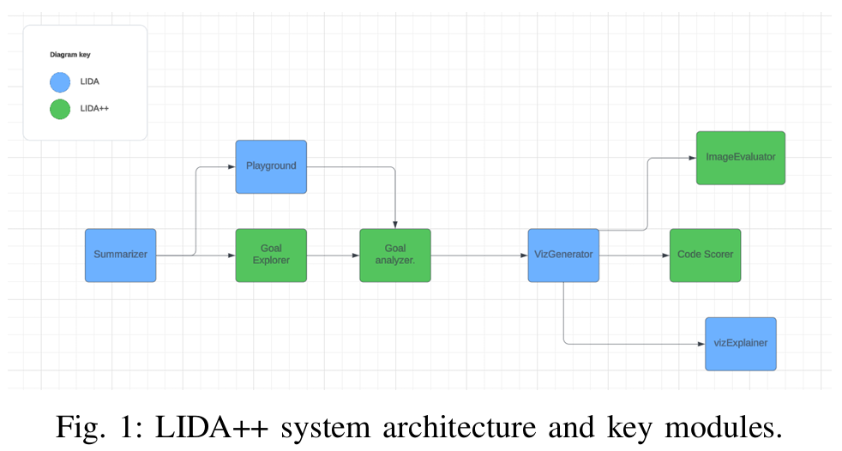

Slide 32
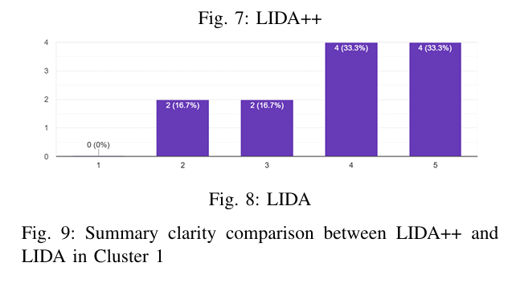

Slide 33

A Comprehensive Guide to Explainable AI: From Classical Models to LLMs
Evolution and Key Models
The sources trace the development of LLMs from early milestones to modern state-of-the-art systems:
BERT (2018): Introduced a bidirectional approach and novel training objectives like Masked Language Modeling (MLM) to capture deep contextual representations.
GPT Series (2018–2023): Emphasized generative, autoregressive capabilities, moving from GPT-2's fluency to GPT-3's few-shot learning and GPT-4's multimodality.
T5 (2019): Unified various NLP tasks into a single text-to-text framework.
LLaMA (2023): Focused on creating efficient, smaller-scale models to improve research accessibility.

Slide 34
The Transformer Architecture
Self-Attention & Multi-head Attention: Dynamically weighs the relevance of different tokens in a sequence.
Positional Encodings: Provides necessary sequential information since the model processes tokens in parallel.
Encoder-Decoder Structure: The encoder generates contextual representations, while the decoder enables autoregressive generation.

Slide 35
The "Black Box" Problem
Despite their success, LLMs are often "black boxes" because their high dimensionality and billions of parameters make it difficult to trace how inputs are transformed into outputs. This lack of transparency creates difficulties in debugging and raises ethical concerns regarding hidden biases in sensitive applications like medical diagnostics or legal decisions.

Slide 36
Interpretability vs. Explainability
Interpretability: Understanding the model's internal workings, such as specific neural activations or layer roles.
Explainability: Providing human-understandable reasons (like visualizations or feature importance) for a model's specific prediction.

Slide 37
Advanced Interpretability Techniques
Gradient-based Methods: Techniques like Integrated Gradients and Saliency Maps identify which input tokens most influence a prediction.
Embedding and Probing Analysis: Using dimensionality reduction (PCA/t-SNE) or "probing classifiers" to see if embeddings capture linguistic features like gender, syntax, or parts of speech.
Layer-wise Analysis: Research shows a functional hierarchy where early layers capture surface-level features, middle layers handle syntax, and late layers encode high-level semantic and task-specific information.

Slide 38
Core Evaluation Metrics
Fidelity and Faithfulness: Fidelity measures how accurately an explanation reflects the underlying model's predictions. It is quantified by a "Fidelity Score," which tracks the agreement between the model's output and the explanation model's output.
Stability and Consistency: Stability refers to the consistency of explanations when an input undergoes slight perturbations (e.g., typos or minor image changes), ensuring that explanations do not fluctuate wildly for similar data points.

Slide 39
Comprehensibility: This metric assesses how easily a human user can understand the provided explanation. While subjective, it can be quantified by "Explanation Simplicity," which considers factors like the number of features used or the length of the text.
Local Accuracy: This focuses on ensuring an explanation is a faithful approximation of the model's decision process within a small, localized region around a specific input instance.

Slide 40
Representativeness: This evaluates whether an explanation generalizes well across a broad set of inputs rather than being tailored to a single outlier or specific instance.

Slide 41
LLMs for Explainable AI: A Comprehensive Survey
Motivation: LLMs as Catalysts for Next‑Generation Explainability
Translate complex model behaviour into human-friendly narratives
Explain not only predictions but also architectural principles, data relationships, and counterfactual reasoning
Adapt explanations dynamically to user needs across levels of expertise

Slide 42
Taxonomy: Three Pillars of LLM‑Enabled XAI
Post‑hoc Explanations
Local explanations (single-instance reasoning via LIME, SHAP, IG)
Global explanations (model‑wide reasoning patterns)
LLM‑enhanced tools that automatically express feature contributions in fluent language
Intrinsic Interpretability
Chain‑of‑Thought (CoT) prompting
Guided reasoning templates
ReAct (Reasoning + Acting) frameworks

Slide 43
Human‑Centered Explanations
User involvement in system design cycles
Cognitive alignment of explanations with human reasoning patterns
Context‑sensitive narratives tailored to expertise, goals, and situational constraints

Slide 44
Evaluation Framework: Qualitative and Quantitative Rigor
Qualitative Metrics
Comprehensibility
Controllability
User trust and utility
Quantitative Metrics
Faithfulness tests (causal intervention, feature ablation)
Plausibility scoring
Benchmarking via datasets (e-SNLI, CoS-E, ECQA, WorldTree, XplainLLM, RAGBench, HateXplain)

Slide 45
Applications Across High‑Stakes Domains
Healthcare: diagnostic explanations, drug‑discovery insights
Finance: transparent credit scoring, fraud detection narratives
Cybersecurity: interpreting intrusion detection features
Legal systems: clarifying case relevance and contractual risks
Education: personalized learning pathways with explanatory feedback
Manufacturing: explainable predictive maintenance
Urban planning: rationalizing infrastructure and congestion decisions

Slide 46
Core Challenges and Limitations
Sensitive data risks and privacy‑preserving explainability constraints
Cultural and societal norm variations that complicate universal explanation design
Bias amplification through social, linguistic, and representational disparities in training data
Multisource data misalignment when explanations require consistent narratives across heterogeneous signals
Structural opacity of deep models, even to LLMs attempting to explain them
Hardware and deployment constraints, especially on edge devices

Slide 47
Future Directions: Where LLM‑enabled XAI Is Heading
Automated Human‑in‑the‑Loop Feedback
Multimodal Explanations
Cross‑Disciplinary Integration

Slide 48
XAI Meets LLMs: A Survey of the Relation between Explainable AI and Large Language Models
“To Explain” LLMs
Attention and neuron‑level visualisation (e.g. BertViz, TransformerLens),
Mechanistic interpretability and circuit discovery,
Knowledge‑graph extraction and causal structure identification,
Faithful reasoning augmentation (e.g. retrieval‑augmented CoT).

Slide 49
“As Feature”
Here, LLM‑generated explanations or rationales are used as auxiliary signals:
Improving smaller models,
Enhancing downstream tasks (e.g. classification, recommendation),
Automating debugging or concept discovery.

Slide 50
Discussion Papers
These works do not implement XAI methods, but address:
Conceptual limitations of LLM explainability,
Human‑centred transparency requirements,
Trust, alignment, and evaluative challenges.
A dedicated subset focuses on benchmarks and metrics, highlighting the lack of robust evaluation frameworks for:
Faithfulness,
Logical consistency,
Causal validity of explanations.

Slide 51
Research Gaps and Future Directions
Faithful explanation of emergent behaviours.
Human‑centred explanation design for diverse stakeholders.
Alignment between mechanistic interpretability and natural‑language explanations.
Regulatory‑grade explainability for real‑world deployment.

Slide 52

ExBERT: A Visual Analysis Tool to Explore Learned Representations in Transformer Models
(including early versions of BertViz) primarily focused on attention weights, which are:
limited proxies for internal computation,
insufficient for understanding neuron‑level representations, layer-wise abstraction, or task‑specific fine‑tuning effects.

Slide 53
Core Contribution
contextual token representations,
nearest-neighbour relationships in embedding space,
layer-wise representation evolution,
and cross-model comparisons (e.g., base vs fine‑tuned models).

Slide 54
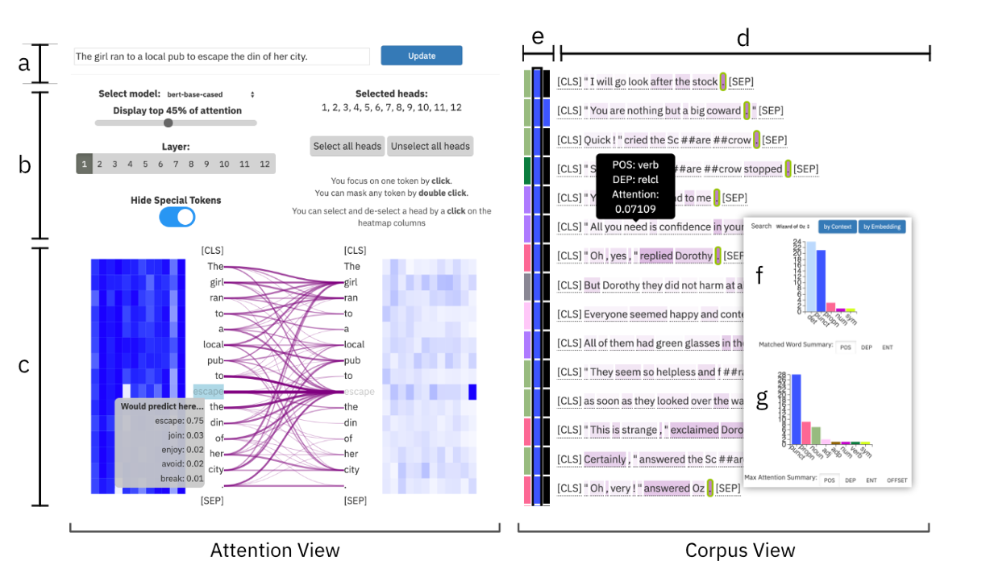

Slide 55
Representation-Centric View
Tokens are contextualised, not static types.
Each token instance is embedded in a high-dimensional latent space, reflecting syntax, semantics, and task signals.
ExBERT enables users to:
select a token in context,
inspect its nearest neighbours across the corpus,
and analyze whether similarity reflects syntactic roles, semantic fields, or task artifacts.

Slide 56
Layer-Wise Abstraction Analysis
lower layers encode surface and syntactic information,
middle layers encode semantic relations,
higher layers encode task- and objective-specific abstractions.
ExBERT allows users to:
compare the same token across layers,
observe shifts in neighbourhood structure,
and identify semantic sharpening, abstraction collapse, or task biasing effects as depth increases.

Slide 57
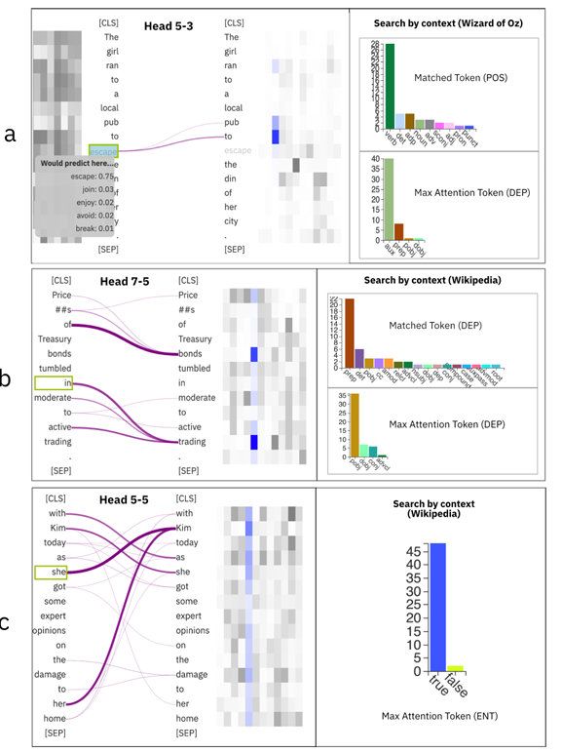
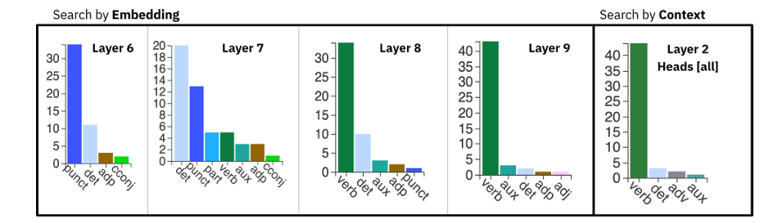

Slide 58
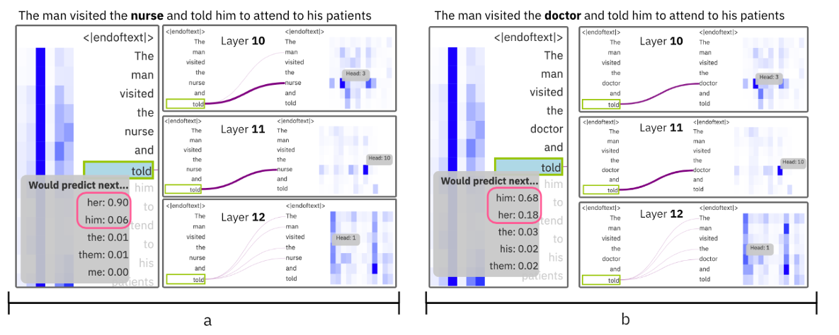

Slide 59
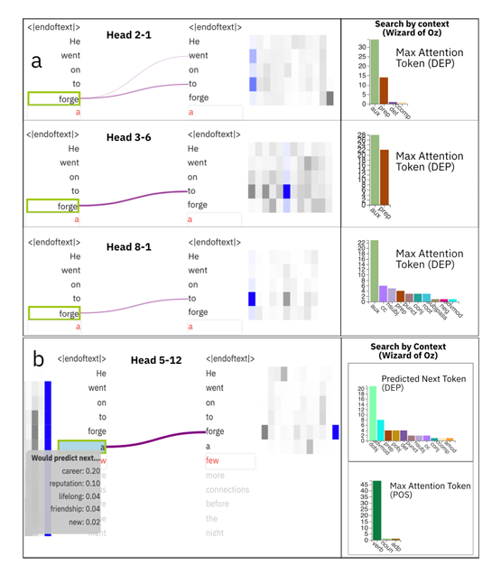
shows strong detection of the AUX dependency.
shows a head detecting the DOBJ dependency

Slide 60
Methodological Positioning
Importantly, ExBERT is not framed as an explanation method in the strict XAI sense:
it does not claim faithfulness guarantees,
it does not output formal causal attributions,
it does not equate interpretability with model correctness.
Instead, it adopts a visual analytics paradigm, where explanation is:
exploratory rather than declarative,
qualitative rather than metric-driven,
theory-guided rather than automated.
This places the work squarely at the intersection of:
representation probing,
human‑centred interpretability,
and interactive machine learning.

Slide 61
Limitations (Explicit and Implicit)
Scalability Nearest-neighbour search and interactive exploration do not trivially scale to very large corpora or modern LLMs (e.g., GPT‑class models).
Faithfulness Like most visualization tools, ExBERT exposes representational correlations, not mechanistic causation.
Expert Bias Insights depend strongly on the analyst’s linguistic intuition; different users may draw different conclusions from the same visualization.

